Slide 1
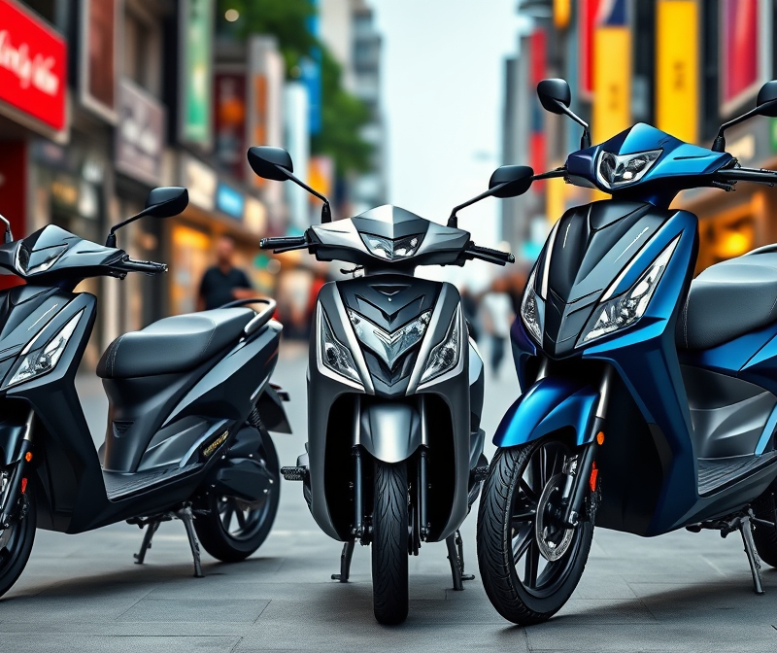
E-Ventura Market Entry Strategy in India

Slide 2
1. Objectives
Assess whether E-Ventura should enter the Indian E2W Scooter market
Devise a GTM Strategy
If yes, determine the most viable mode of entry and strategy for success.

Slide 3
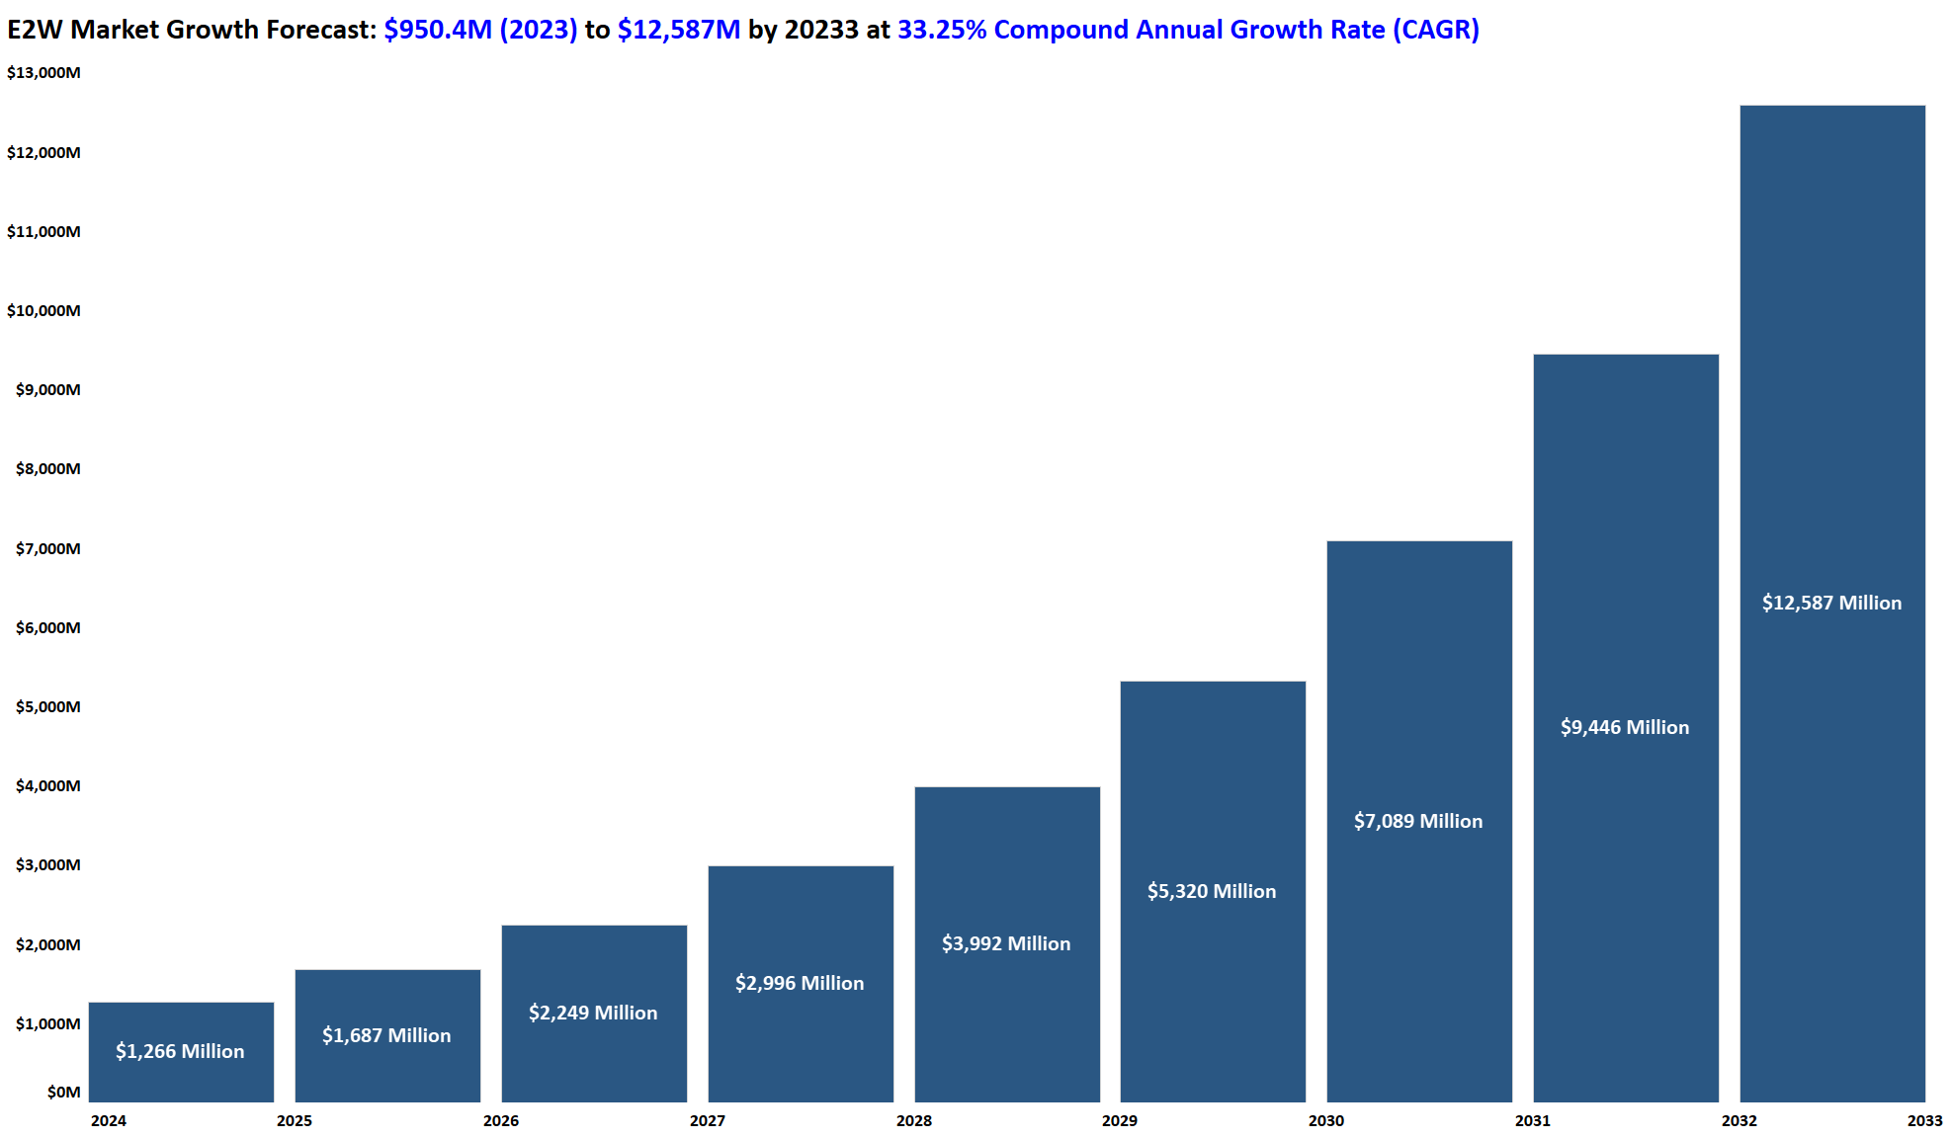
2. India's E2W market is experiencing exponential growth, driven by increased environmental awareness and government incentives
E2W Market Growth Forecast: $950.4M (2023) to $12.6B by 2033 at 33.25% CAGR
Market size: $950.4 million in 2023, projected to grow at 33.25% CAGR to $12.6 billion by 2032.
E2Ws to constitute 60-70% of scooter sales by 2030.
Government incentives and GST reduction to 5% significantly boost adoption.

Slide 4
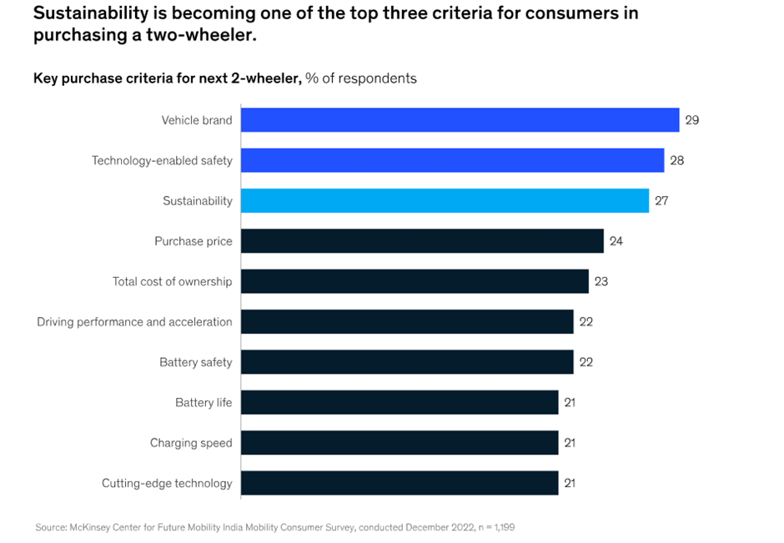
3. Affordability, range, and charging infrastructure are critical factors for EV adoption.
86% of surveyed buyers are considering EV two-wheelers due to lower operational costs.
Key purchasing factors: safety, range, battery life and charging speed
Key concerns: Range anxiety, limited charging infrastructure, and high battery replacement costs.

Slide 5
4. Three distinct consumer archetypes dominate the E2W market.
Cost-constrained consumers
Focused on affordability and maintenance
Students and delivery partners
Early Adopters
Focused on premium features and innovative design
Tech Enthusiasts
Micromobility Enthusiasts
Focused on usability and convenience
Everyday commuters

Slide 6
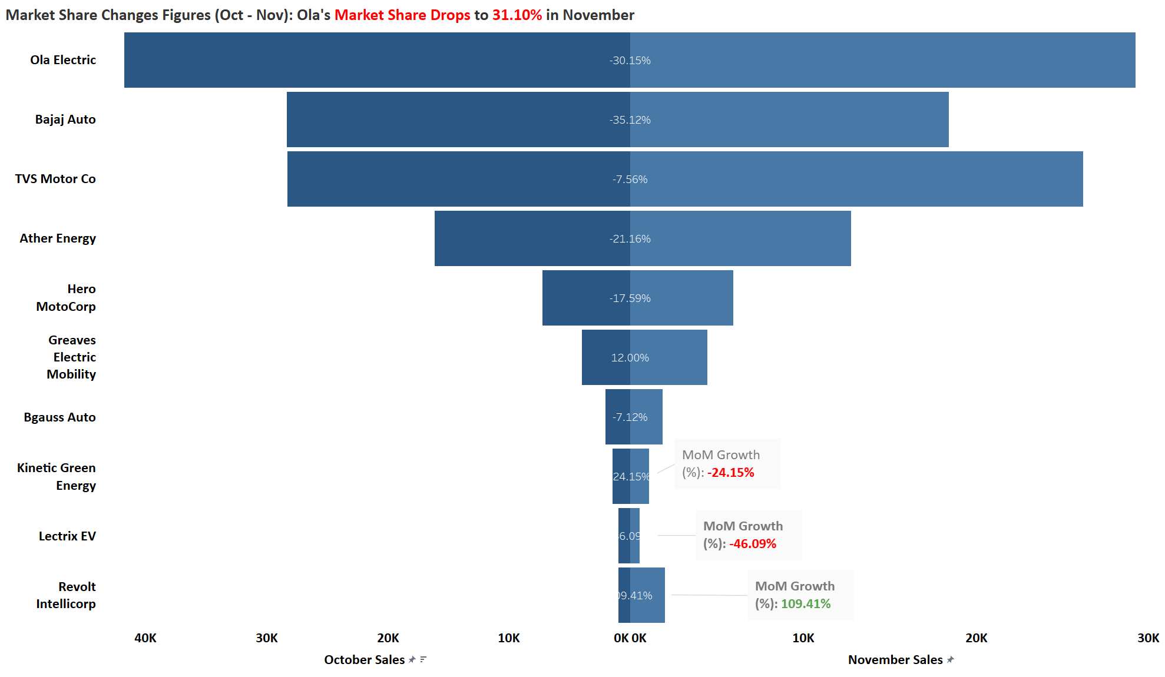
5. E2W Scooter market Dominated by key players like Ola, Bajaj, and TVS, with opportunities for differentiation.
Market share: Ola (31.1%), TVS (27.87%), Bajaj (19.6%).
Ola’s edge: 115 km/charge range, D2C model, and aggressive pricing.
Key differentiation opportunities: Affordable scooters with high range (80-120km)

Slide 7
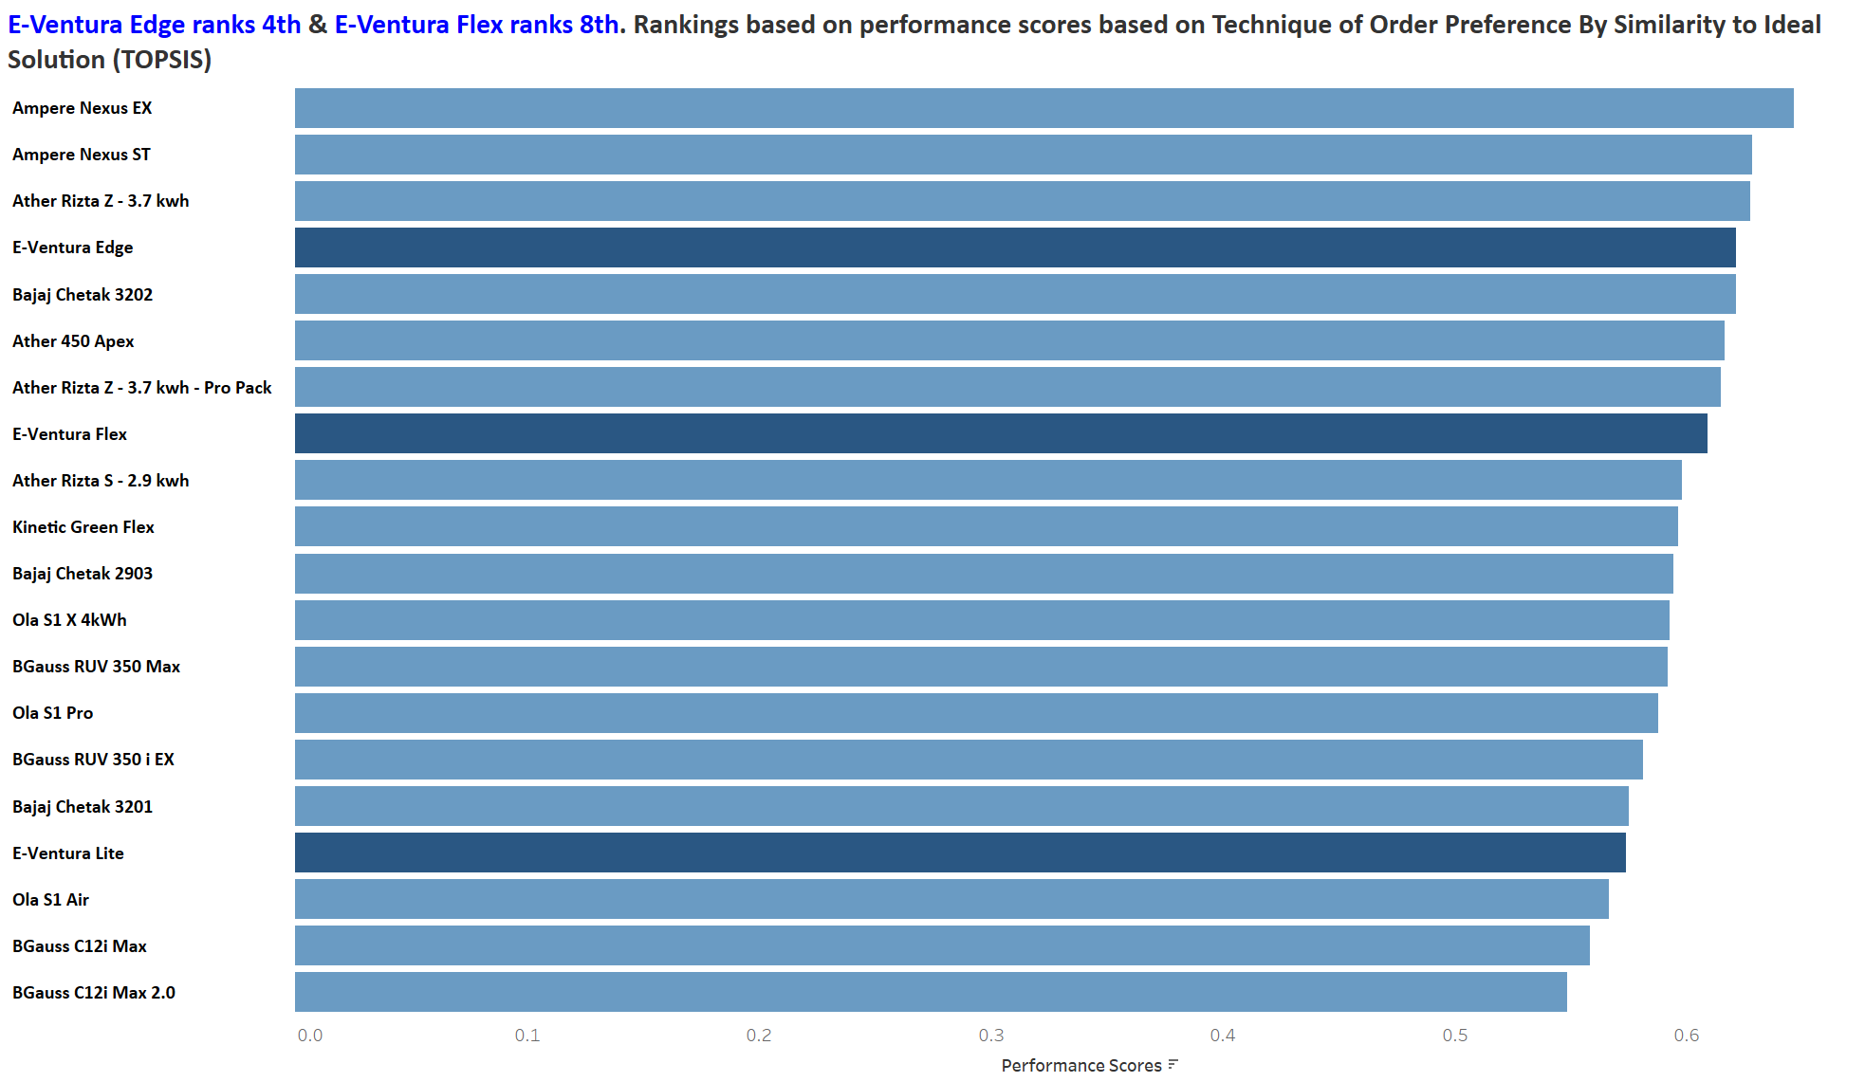
6. E-Ventura products have a strong standing amidst the competitive landscape of India.
E-Ventura Edge (Premium Vehicle) ranks 4th and the E-Ventura Flex (Mid-Range scooter) ranks 8th.
E-Ventura’s strong positioning based on price and features enables it to compete with other competitor’s product portfolio.

Slide 8
7. SWOT Analysis
Government subsidies and incentives
Favourable tax policies
Localisation support through PLI
Competitor innovation improves market
Strengths
Policy changes reducing incentives
Intense competition and price wars
Range anxiety and battery safety issues
Geopolitical risks on raw materials
Threats
Growing environmental awareness
Expanding EV market size
Advancements in battery technology
Untapped rural and micromobility market
Opportunities
Inadequate charging infrastructure
Weaknesses
High initial costs
Dependence on imported batteries
Heavy reliance on government subsidies

Slide 9
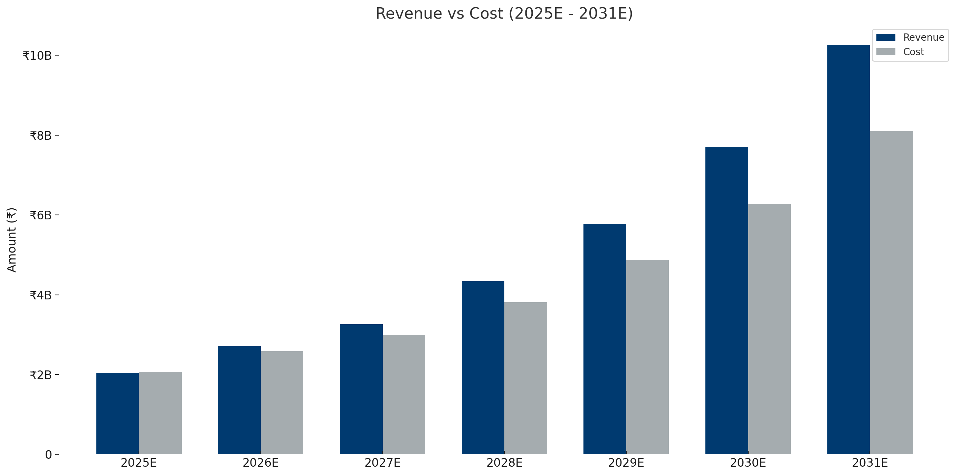
8. The investment is expected to be a success
Capturing 2% SOM yields an NPV of ₹183 million, an IRR of 33%, and cost recovery within 3.92 years.
Achieving 2-7% SOM ensures long-term scalability and profitability through localisation and differentiation.

Slide 10
9. Different modes of entry
Wholly Owned Subsidiary
Disadvantage: High initial investment and regulatory hurdles.
Joint Venture
Advantage: Shared investment and risk; access to local partner’s market knowledge.
Disadvantage: Potential conflicts over management and profit-sharing; less control over operations.
Partnership
Advantage: Quick market entry with low investment; access to established networks.
Disadvantage: Limited control over branding and long-term strategic direction.
Acquisition
Advantage: Immediate market presence and access to infrastructure/customer base.
Advantage: Complete control over operations, branding, and profits; leverage PLI incentives for cost reductions.
Disadvantage: High upfront costs and potential challenges with integration and legacy issues.

Slide 11
10. Wholly owned subsidiary recommended for total control and branding
Direct PLI Access
Enhanced Localisation
Full eligibility for 13-15% grants on EV sales and 2% bonus for ₹10,000 crore revenue ensures maximum incentive utilisation.
Profit Retention
In-house manufacturing lowers costs by reducing reliance on imports, aligning with PLI requirements.
Scalability
Full ownership ensures all cost savings and profits from PLI remain with E-Ventura.
Competitive Pricing
Allows agile expansion and localisation to meet PLI benchmarks without external constraints.
Lower costs enable affordable pricing, driving market penetration in India’s price-sensitive market.

Slide 12
11. GTM Strategy: Pre-Launch
Pilot Programme
Deploy 50 scooters in 2 metro cities (e.g., Pune, Bangalore) to gather feedback.
Partnership Engagement
Fleet Sales Outreach
Engage with fleet buyers (e.g., Zomato, Swiggy, e-commerce delivery providers).
Influencer Marketing
Collaborate with regional influencers to promote EV adoption and sustainability.
Onboard charging infrastructure partners (e.g., malls, fuel stations, corporates).
Green Drive Initiative
Organise city-wide tree-planting campaigns tied to the brand’s eco-friendly promise.
KPI: 50 units in 2 metro cities, 200+ customer feedback collected
KPI: 50+ stations secured
KPI: 3+ fleet partnerships confirmed for pre-launch
KPI: 30K audience reached
KPI: 5000 trees planted.
Purpose: Establish brand awareness, build trust and build general interest.
Timeline: 4-6 months

Slide 13
12. GTM Strategy: Launch
Direct-to-Consumer (D2C)
Launch an e-commerce platform with doorstep delivery options and EMI financing.
Experience Centres
Dealership Network
Partner with dealerships in Tier-2 cities to provide localised access to scooters.
Fleet Sales
Finalise contracts with corporate buyers and delivery companies.
Onboard charging infrastructure partners (e.g., malls, fuel stations, corporates).
Launch Event
Host launch events in key metros with live demos, test rides, and influencer participation.
KPI: 2K scooters sold online
Digital Marketing
Regional Advertising
Referral Programmes
Focus on Google Ads, YouTube, and Instagram with region-specific campaigns.
Run vernacular campaigns (TV, radio, outdoor) to connect with local audiences.
Offer incentives for early adopters who refer friends and family.
KPI: 15,000 in-store footfalls
KPI: 20+ dealerships operational in T1 and T2 cities
KPI: 3+ fleet contracts signed, 1,000+ units booked
KPI: 1,000+ attendees, 300+ test drives conducted and feedback collected
KPI: 10,000+ website visits, 5m+ impressions.
KPI: 70% brand recall in target regions
KPI: 2,000+ referrals generated in 3 months
Purpose: Drive conversions and expand sales through multichannel availability
Timeline: 3 months

Slide 14
13. GTM Strategy: Post Launch
Direct to consumer (D2C)
Enhance the e-commerce platform with faster delivery and new financing options.
Tier-2/3 City Expansion
Subscription Services
Introduce battery swapping and extended warranty plans for existing users.
B2B Partnerships
Deepen fleet sales relationships and explore government contracts for EV fleets.
Expand dealership networks to 50+ Tier-2/3 cities within 12 months
Loyalty Programmes
Offer rewards for repeat purchases, servicing, and referrals.
Content Marketing
Share customer testimonials and EV adoption stories through blogs and social media.
Sustainability Reports
Publish impact metrics (trees planted, emissions saved) to reinforce brand values.
Community Events
Host annual customer meetups and rides to strengthen brand loyalty.
KPI: 50+ cities operational within 12 months.
KPI: 10,000+ subscriptions signed within 6-7 months
KPI: 3,000+ fleet units sold annually.
KPI: 90% on time delivery
KPI: 2m+ views annually, 20k+ shares on content
KPI: 4 reports annually, 20,000 views total on reports.
KPI: 10,000+ participants
Purpose: Scale operations, enhance customer loyalty, try new channels, upscale working channels and downscale underperforming channels.
Timeline: 6-12 months

Slide 15
14. Recommended exit strategy if goals are not met within 5 years
Performance-Based Evaluation
Set metrics (e.g., 2% market share, break-even in 5 years).
Initiate exit if targets are unmet.
Asset Liquidation
Sell manufacturing facilities, equipment, or infrastructure to local players.
Strategic Partnerships
Form joint ventures or divest operations to established competitors.
Customer Base Monetisation
Transfer brand equity and customer base to market leaders.
Policy Utilisation
Leverage government incentives to minimise financial losses.
Gradual Phase-Out
Reduce operations regionally while maintaining customer support.

Slide 16
15. Caveats
Policy Risks
Market Variability
Infrastructure Delays
Changes in government subsidies could alter pricing and adoption dynamics.
Competition and supply chain issues may impact projections.
Limited expansion of charging networks could affect penetration rates.

